Slide 1


Session 02: Software Requirements
Discovery, Analysis, Specification, Validation, and Management
Introduction to Software Engineering | HUFLIT University

Slide 2

Learning Objectives
Understand the Types of Requirements (Functional vs. Non-functional).
Master the Requirements Process: Elicitation to Management.
Apply Classification Criteria to optimize development priority.
Define professional Deliverables: SRS, User Stories, and Backlogs.

Slide 3
What is a Requirement?
A condition or capability needed by a user to solve a problem or achieve an objective.
User Requirements: Abstract statements in natural language for customers.
System Requirements: Detailed functional/technical specifications for developers.

Slide 4
Part 1: Types of Requirements

Slide 5
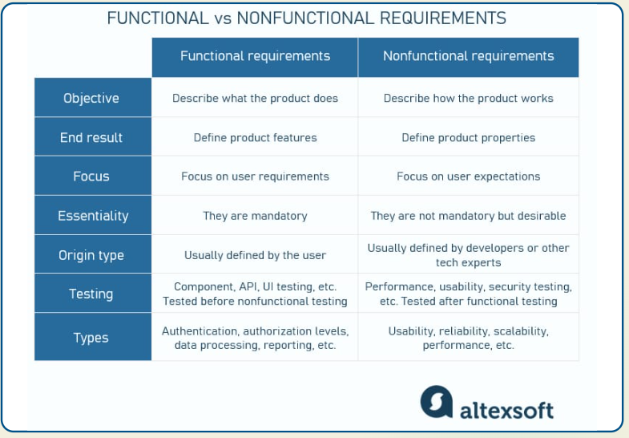

Functional Requirements (FR)
Define WHAT the system should do.
•
Describes services and functions the user expects.
•
Covers data processing, logic, and state behavior.
•
Usually includes "The system shall..." statements.

Slide 6
Non-Functional Requirements (NFR)
Define HOW the system should behave.
•
Quality attributes, performance, and constraints.
•
Affect the system as a whole, not individual functions.
•
Failure to meet NFR can render a system unusable even if functions work.

Slide 7
Domain Requirements
Requirements derived from the specific application domain (e.g., Banking, Healthcare).
•
May be functional or non-functional.
•
Implicit knowledge that developers might miss.
•
Critical for legality and industry compliance.

Slide 8
Part 2: Requirement Classification

Slide 9

Classification by Origin
Stakeholder Needs
Technical Constraints
Direct requests from users, managers, or external partners.
Hardware limits, OS compatibility, or legacy database integrations.
Legal/Regulatory
Business Goals
Privacy laws (GDPR), accounting standards, or safety protocols.
Revenue growth, user retention, or competitive edge features.

Slide 10
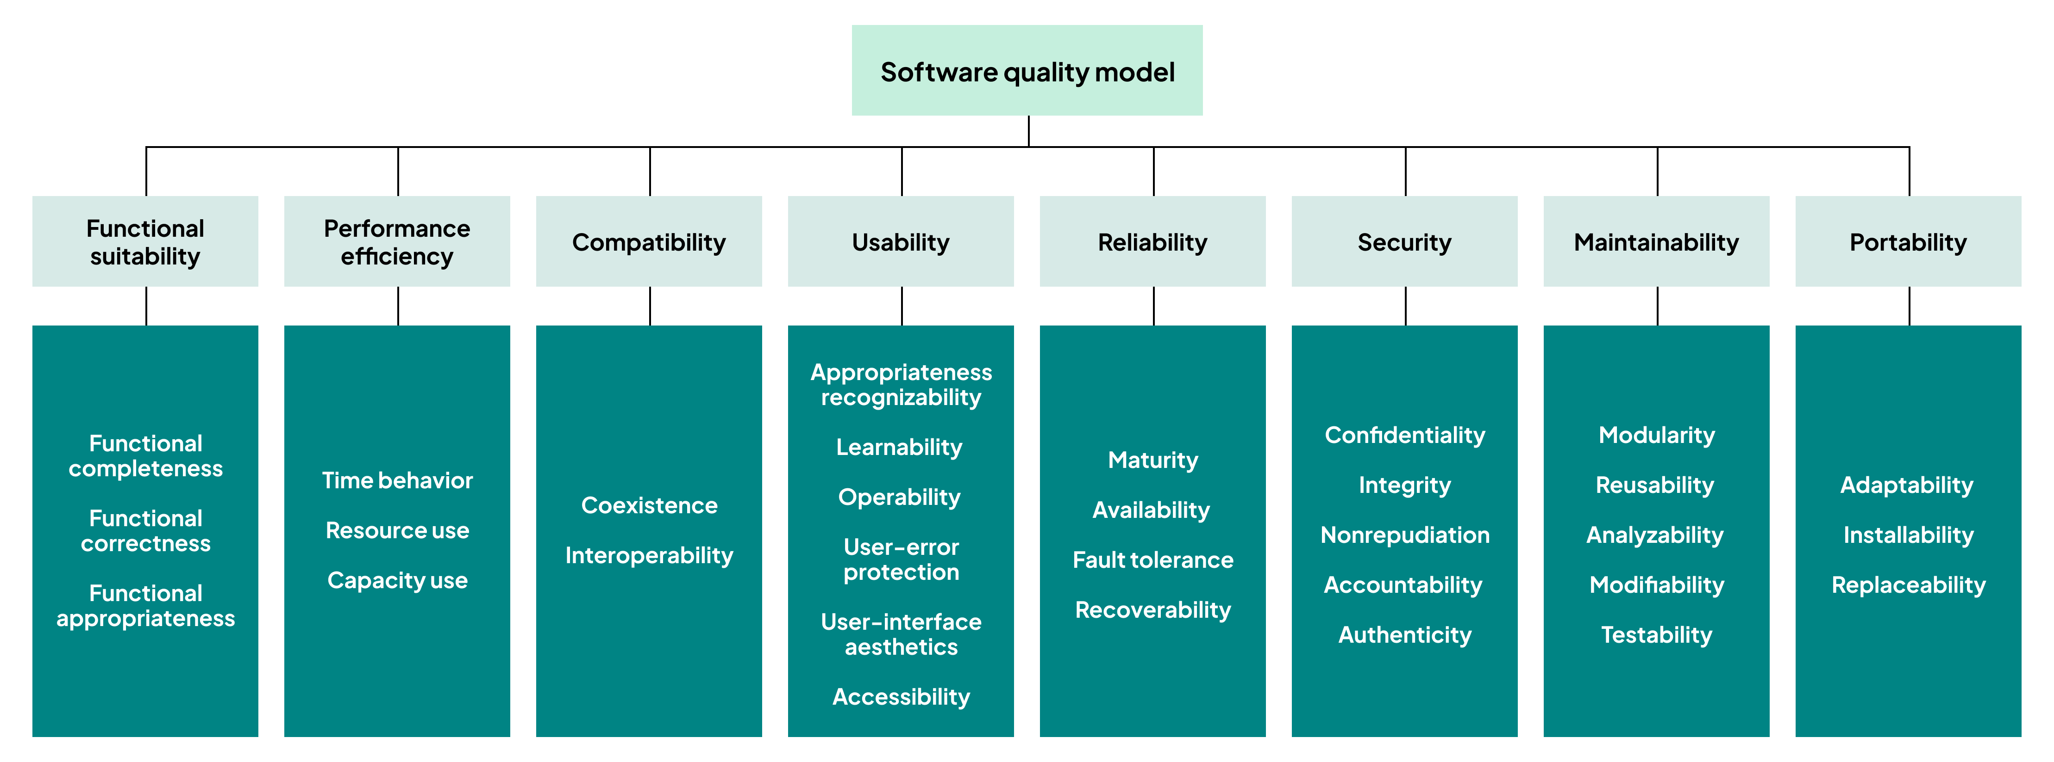
Classification by ISO/IEC 25010 Quality Model
Usability: Ease of learning and use.
Reliability: Maturity, availability, fault tolerance.
Performance: Time and resource efficiency.
Security: Integrity, accountability, confidentiality.

Slide 11
Classification by Processing Form
CRUD Operations
Search & Retrieval
Create, Read, Update, Delete entities (e.g., Manage User Profiles).
Filtering, sorting, and complex queries (e.g., Find nearby clinics).
Computation
Reporting/Statistics
Calculations, algorithms, and business logic (e.g., Calculate monthly interest).
Data aggregation and visualization (e.g., Annual revenue chart).

Slide 12
Classification by Difficulty & Priority
•
Low Difficulty: Standard CRUD, well-known UI components.
•
Medium Difficulty: Complex search filters, integration with 3rd party API.
•
High Difficulty: Real-time AI processing, ultra-secure financial cores.

Slide 13
Part 3: The Requirements Engineering Process

Slide 14
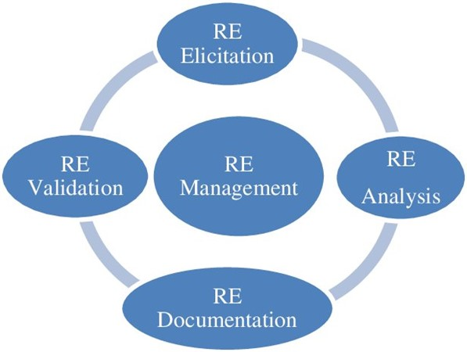
The RE Process Spiral
RE is not linear; it is iterative.
Elicitation: Discovering the needs.
Analysis: Understanding and resolving conflicts.
Specification: Documenting findings.
Validation: Ensuring it matches user intent.
Management: Tracking and Change control

Slide 15
Phase 1. Requirement Elicitation
The goal is to get stakeholders to talk about their problems and desired solutions.
Stakeholders are often poor at articulating needs.
Domain experts use jargon that developers miss.
Political/Power structures in organizations influence what is said.

Slide 16


Step 1: Identifying Stakeholders: The "Who"
Elicitation fails if you miss critical perspectives. Use these steps:
Organizational Mapping: Look at the hierarchy. Who pays? Who manages? Who uses?
Process Analysis: Follow the data. Who provides input? Who handles errors?
The "Snowball" Technique: At the end of every interview, ask: "Who else should I talk to regarding this process?"
Stakeholder personas help identify conflicting interests early in the process.
•
•
Who has a "stake" in the system?
•
Direct Users: People operating the software.
Management: Business owners and sponsors.
External Actors: API users or regulatory bodies
Industrial Case: In a Payroll system, don't just talk to HR. Talk to the Tax Accountant and the Internal Auditor to ensure legal compliance.

Slide 17
Step2: Identifying Domain Knowledge
Source | Description
Business Manuals | Standard Operating Procedures (SOPs).
Existing Systems | Legacy software or manual processes being replaced.
Market Standards | Industry regulations (GDPR, HIPAA).

Slide 18
Step 3: Raw Gathering
This is where techniques are applied. The focus is breadth over depth at this stage.
Goal: Capture every possible idea, pain point, and "exciting" requirement without judgment.

Slide 19

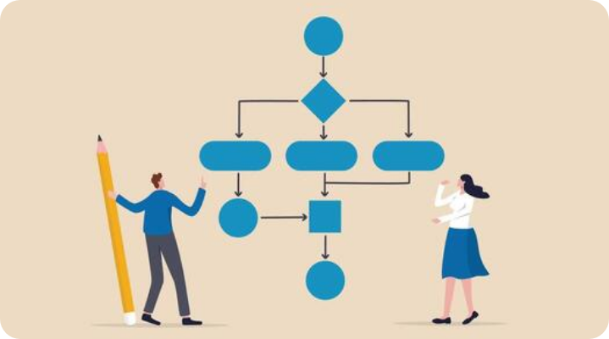
Gathering Processes & Workflows
Capture how data flows and how tasks are executed within the system.
As-Is Workflow: Current manual/legacy steps.
To-Be Workflow: The optimized future state.
Business Rules: Logic, constraints, and formulas.
Data Entities: Key information objects and relations.

Slide 20





Gathering Quality & Constraints
Performance
Security
Constraints
Response times, throughput, and scalability expectations.
Authentication, data encryption, and audit logs.
Budget, timeline, legal, and technical limitations.
"Quality attributes define how the system must behave under pressure."

Slide 21
Gathering Artifacts - Forms & Documents
Why Gather Forms?
Forms (Paper or Excel) are the "skeleton" of system data. Collecting current artifacts helps to:
Data Fields: Identify exact fields (names, data types, lengths).
Validation Rules: Determine mandatory fields and default values.
Output Mapping: Design reports that match the formats users are familiar with.

Slide 22
Gather Regulations & Business Rules
The Logic of the System
Regulations are legal or operational constraints that the software must strictly follow:
Calculations: Formulas for taxes, discounts, payroll, or loyalty points.
Compliance: Data privacy laws (GDPR, local data protection decrees).
Permissions: Approval workflows (who has the authority and what are the limits).

Slide 23
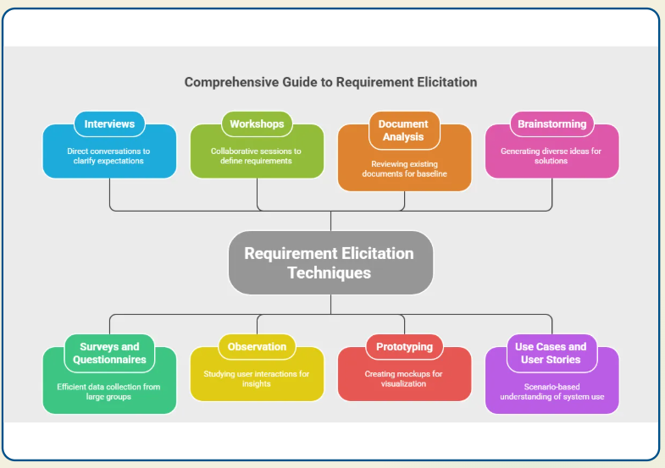
Requirement Elicitation Techniques
The goal is to get stakeholders to talk about their problems and desired solutions.
Stakeholders are often poor at articulating needs.
Domain experts use jargon that developers miss.
Political/Power structures in organizations influence what is said.

Slide 24
Technique 1: Interviews
•
Closed Interviews: Pre-defined set of questions. Good for confirmation.
•
Open Interviews: Exploration of issues. Good for discovery.
•
Best Practice: Use a mix. Listen more than talk.

Slide 25
Technique 2: Workshops (JAD)
Joint Application Development (JAD) sessions involve intensive group work.
Advantage: Conflict resolution happens in real-time as all decision-makers are present.

Slide 26
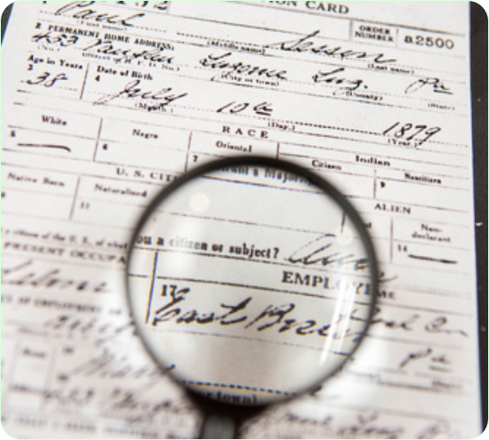
Technique 3: Document Analysis
Mining current paper trails or manual forms.
Helps identify business rules and data entity lifecycles.

Slide 27
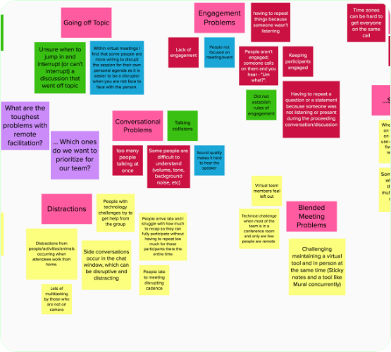
Technique 4: Brainstorming
A non-judgmental environment to generate creative ideas
Rule: Quantity over quality initially. All ideas are recorded.

Slide 28

Technique 5: Surveys
Questionnaires for large groups. Great for quantitative validation.
Challenge: Low response rates and potential for biased questions.
Usage Tip
Use surveys after interviews to see if a specific pain point is shared across the whole user base.

Slide 29
Technique 6: Observation
Also known as "Ethnography." Watching users in their actual working environment.
Effective for uncovering "obvious" steps that users forget to mention.
Best for complex, multi-step manual processes being automated

Slide 30
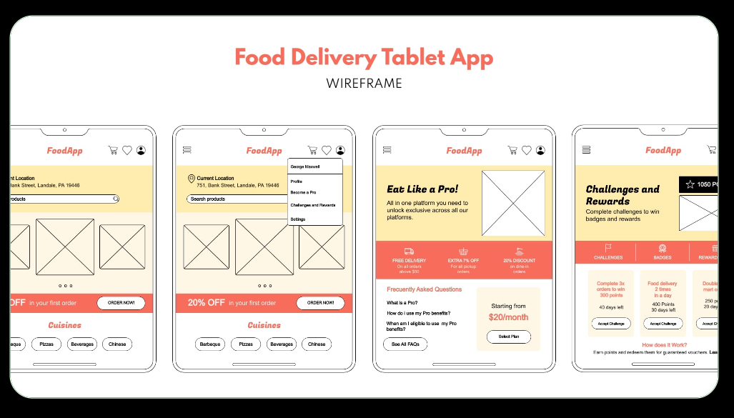
Technique 7: Prototyping
A visual representation of the final product.
Triggers much higher quality feedback than a text document alone.

Slide 31
Technique 8: Scenarios (Use case & User Stories)
Descriptions of example interaction sessions.
•
People find it easier to relate to real-life stories.
•
Scenarios include: Initial state, normal flow, what can go wrong, and other concurrent activities.

Slide 32
Choosing the Right Mix
Technique | When to Use
Interviews | Strategic vision or detailed expert knowledge.
Observaton | Complex manual processes.
Prototyping | Novel or unclear user interfaces.
Surveys | Statistically significant large-scale feedback.

Slide 33


Identifying FRs and NFRs
Functional (The "What")
Non-Functional (The "How well")
Ask: "What task are you trying to complete?“
Focus on actions, data flow, and business rules.
Ask: "What happens if 1000 people do this at once?" or "How long are you willing to wait for this result?“
Focus on constraints and quality attributes.
Tip: Users often forget NFRs because they take them for granted (e.g., security).
Prompting Technique: Use "What-if" scenarios to trigger NFR discovery.

Slide 34


Probing Questions
For Forms:
For Regulations:
"Which official document specifies this salary formula?"
"Which columns in this Excel file are the most critical?"
"Are there any exceptions that do not follow this rule?"
"Where is the source of this data before it reaches this form?"
"What is the required data retention period for these records?"

Slide 35
Identifying Degree of Support (DoS)
Not every requirement needs 100% automation. DoS determines the "Depth" of implementation:
•
Full Support: Completely automated. No human intervention (e.g., Auto-calculating tax).
•
Partial Support: System assists the human (e.g., Providing a dropdown list of medicines).
•
Indirect Support: System provides data, but the action is external (e.g., Generating a report for a manual board meeting).
Strategy: High-risk/High-volume tasks deserve Full Support. Rare/Subjective tasks often only need Partial Support.

Slide 36
Elicitation & Support Matrix
Stakeholder | Requirement Type | Requirement Summary | Degree of Support
Clerk | Functional | Record patient check-in time | Full (Auto-timestamp)
Doctor | Functional | Diagnose complex mental condition | Partial (Decision Support)
IT Manager | Non-Functional | System uptime must be 99.9% | System-wide (Monitoring)
Auditor | Non-Functional | Audit trail for all data changes | Full (Logging)

Slide 37

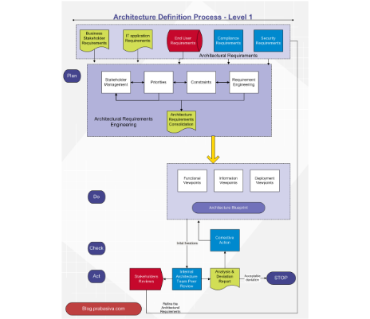
From Elicitation to Decision
Once elicitation is done, the Degree of Support informs Prioritization:
•
Criticality: If DoS is "Full" but the task is rare, reconsider the ROI.
•
Feasibility: Does the current tech stack allow the required DoS?
•
Consensus: Do different stakeholders expect different levels of support for the same task?
Pro Tip: Use the DoS to define the "Definition of Done" in Agile Sprints.

Slide 38

Elicittion Checklist (5W1H)
Who: Who will use the feature and provide inputs?
What: What must this feature ultimately achieve?
Why: Does this match our business goals?
When: When will this be used (frequency/deadline)?
Where: Where will users access the system (home/office)?
How: How should the system respond to user actions?

Slide 39
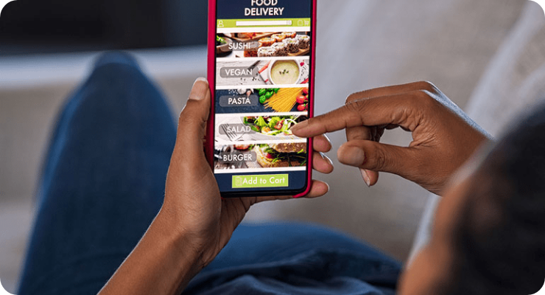
Insight: Needs vs. Wants
Users often describe solutions, not problems. The analyst's job is to peel back the layers to find the core business need.
Don't be a "Waiter" taking orders; be a "Doctor" diagnosing the underlying issue.

Slide 40





Elicitation Best Practices
Tacit Knowledge
Resistance
Conflicting Needs
Things stakeholders think are too "obvious" to mention but are critical.
Stakeholders fearing change or automation replacing their roles.
Marketing wants features; Security wants restrictions.
Scope Creep
Ambiguity
Changing Mind
Elicitation sparking an endless "wish list" that exceeds the budget.
Same words meaning different things to different stakeholders.
Requirements evolve as users learn what is possible.

Slide 41
Elicitation Best Practices
Active Listening: Listen 80%, Speak 20%.
Avoid Jargon: Speak the stakeholder's language.
Confirm Everything: "So, what I hear you saying is..."
Be Transparent: Explain why some features might be out of scope.

Slide 42
Phase 2. Requirements Analysis
Cleaning and structuring what was elicited.
•
Classification: Group related needs.
•
Conflict Resolution: Negotiate between stakeholders.
•
Prioritization: What is critical vs. nice-to-have?

Slide 43

Conflict Resolution
Stakeholders often have conflicting needs. Negotiation facilitates trade-offs to reach a consistent and achievable final requirements set.
Identify overlaps and conflicts.
Quantify business value vs technical cost.
Gain written sign-off on compromises.

Slide 44




Prioritization Strategy: MoSCoW
Must have
Should have
Critical to business success. Non-negotiable.
Important but not vital. Can be delayed if needed.
Could have
Won't have
Desirable but small impact. Low cost.
Agreed not to include in this current release.

Slide 45
Phase 2. Requirements Specification (SRS)
Cleaning and structuring what was elicited.
•
Classification: Group related needs.
•
Conflict Resolution: Negotiate between stakeholders.
•
Prioritization: What is critical vs. nice-to-have?

Slide 46

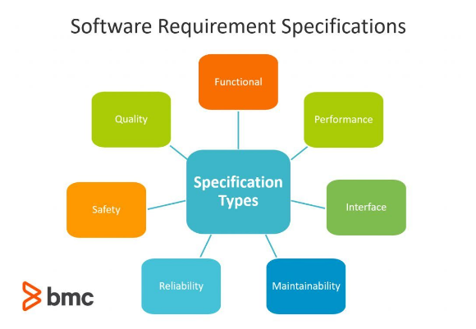
The SRS Document
Software Requirements Specification (SRS) is the "Contract" between client and developer.
•
Provides a foundation for software design and testing.
•
Reduces development effort through up-front clarity.
•
Used for estimation and resource planning.

Slide 47

SRS Structure (IEEE 830)
Introduction
General Description
Purpose, Scope, Definitions, References.
User classes, Constraints, Assumptions.
Specific Requirements
Appendices
Functional, Performance, Security, Safety.
Data models, Algorithms, User manuals.

Slide 48
Ensuring Completeness
•
Traceability Matrix: Link each requirement to its origin.
•
Requirement Reviews: Peer and customer walkthroughs.
•
Prototyping: Build low-fidelity mocks to reveal "I forgot about this" moments.

Slide 49
Phase 4: Requirements Validation
Checking that requirements actually define the system the customer wants.
•
Validity: Does the user really need this?
•
Consistency: Are there contradictions?
•
Completeness: Is anything missing?
•
Realism: Can we build this with our budget?

Slide 50
Phase 5: Requirements Management
Tracking and Change Control

Slide 51
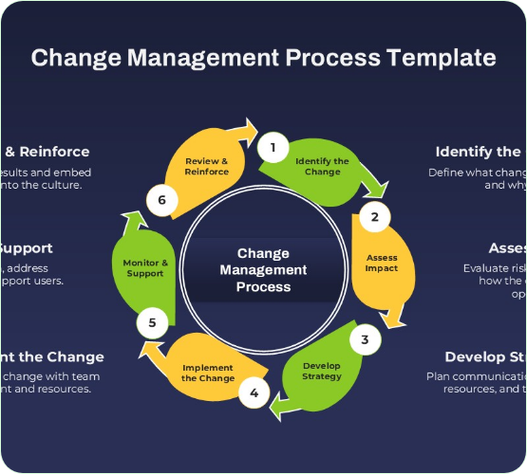
Change Control
Requirements will change. The CCB ensures changes are reviewed for impact on cost, time, and quality.
Impact Analysis: Predicting the ripple effect of a single change across the system.

Slide 52
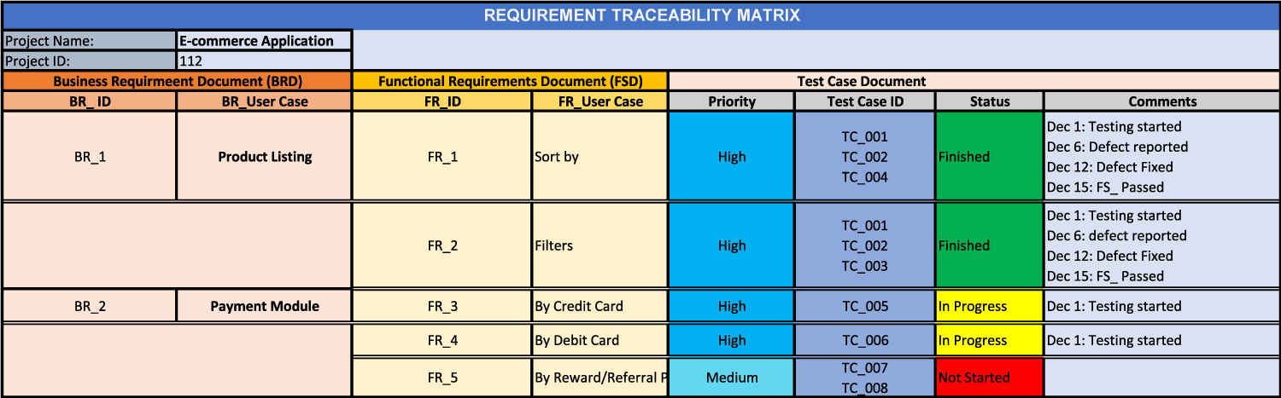
Traceability Matrix (RTM)
A table linking requirements to sources and to test cases.
Ensures that every requirement is fulfilled and every test case is justified.

Slide 53
Part 4: Requirements in Agile

Slide 54
User Stories
A user-focused alternative to formal specifications.
User stories are placeholders for conversation.
Kept simple, often written on physical cards.

Slide 55
The 3C's of User Stories
Card
Conversation
Confirmation
A physical or digital card to represent the intent.
Discussion with the team to flesh out details.
Acceptance criteria to verify completion.

Slide 56
INVEST in Good Stories
Independent - Should be self-contained.
Negotiable - Not a fixed contract.
Valuable - Must provide value to user.
Estimable - Developers can gauge effort.
Small - Fits within a single sprint.
Testable - Has clear pass/fail criteria.

Slide 57
Acceptance Criteria (AC)
Define the Boundaries of the story. Often written in Gherkin style:
•
Given: [Context/Pre-condition]
•
When: [Action/Trigger]
•
Then: [Observable Outcome]

Slide 58
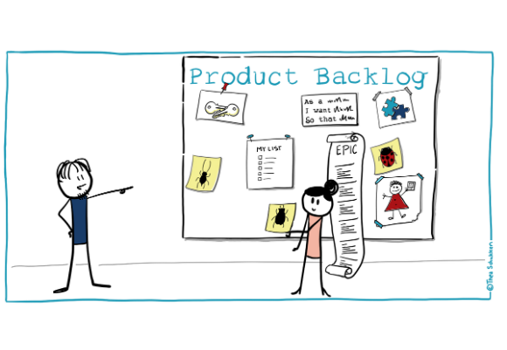
The Product Backlog
The single source of work in an Agile project.
•
Includes User Stories, Bugs, and Tech Tasks.
•
Ordered by Priority and Value.
•
Managed by the Product Owner.

Slide 59
Which Approach to Use?
Plan-Driven (SRS)
•
High-risk projects (Medicine, NASA).
•
Stable environments.
•
Large, distributed teams.
Agile (User Stories)
•
Rapidly changing markets.
•
Startups and web apps.
•
Co-located, collaborative teams.

Slide 60

Core Message
"If you don't know where you are going, any road will take you there." — Requirements are the foundation of all engineering decisions.

Slide 61
Session Summary
•
RE is about discovered user intent, not just functions.
•
Non-functional requirements often define the architecture.
•
Validate early to avoid the "Requirements Gold-Plating" trap.
•
Agile RE focuses on continuous conversation.

Slide 62
Questions?
Thank you for your attention.

